Slide 1
TestContainers

Slide 2


Slide 3
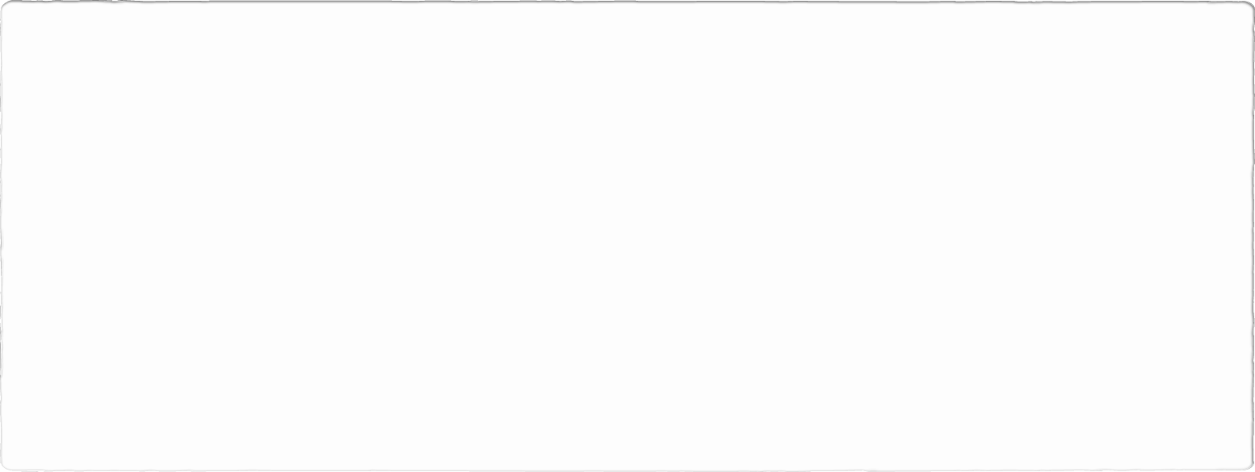
Krav
Windows, Linux, MacOS
Docker API kompatibel konteiner «runtime»

Slide 4
WebApplicationFactory
Nugets
Microsoft.AspNetCore.Mvc.Testing
Mentions
FluentAssertion ( Fluent syntax -> customer.should.be.x
Bogus ( new customer -> random.firstname,lastname-> generate ( 10 ) returns a list or 1.

Slide 5
Docker

